Slide 1
NoC Performance Analysis Tool with Hybrid Arbitration

Slide 2
Agenda
Recap
New Modifications
Sample Results
Next Steps

Slide 3
INHERITANCE
PRIMITIVE
(Base Class)
Queue
Injector
Arbiter
Sink
Split
Priority Arbiter
RoundRobin
Arbiter

Slide 4
NETWORK OBTANED USING INPUT FILES
Statistics.txt file
Network.txt
RR1
F1 = 0.2,9.2
F2=0.8,1.21
F3= 0.7,0.8
N1:F1,Q1
N2:F2,Q2
N3:Q1,RR1(N3;N4)
N4:Q2,RR1(N3;N4)
N5:RR1(N3;N4),Q4
N6:F3,Q3
N7:Q4,PR1(N7;N8)
N8:Q3,PR1(N7;N8)
N9:PR1(N7;N8),S1
Q1
N1
N3
PR1
Q4
N5
N7
RR1= 2,0
PR1= 0.3,0
Q1=6,1
Q2=7,1
Q3=2,1
Q4=8,1
N2
N4
N9
Q2
Q3
N6
N8

Slide 5
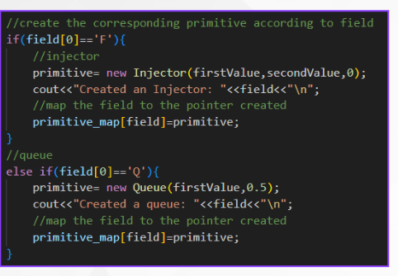
READING STATISTICS.TXT FILE
Statistics.txt
F1 = 0.2,9.2
F2=0.8,1.21
F3= 0.7,0.8
RR1= 2,0
PR1= 0.3,0
Q1=6,1
Q2=7,1
Q3=2,1
Q4=8,1
Based on the field parts (F,Q,RR,PR) in the file corresponding primitive objects (injector,queue,...) are created by gving the suitable instances like buffersize for queue, injection rate for injector, etc.....
Fn(injector)=Injection Rate, Squared coefficient of variation of inter arrival time
Qn(Queue)=Buffer size, Type(FIFO)
RRn or PRn (Arbiter) = Service time, Squared coefficient of variation of service time

Slide 6
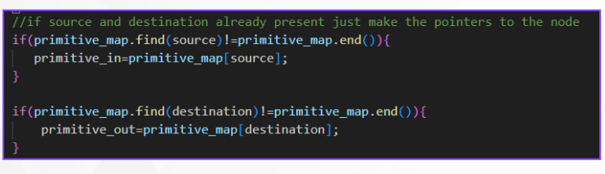
READING NETWORK.TXT FILE
Network.txt
N1:F1,Q1
N2:F2,Q2
N3:Q1,RR1(N3;N4)
N4:Q2,RR1(N3;N4)
N5:RR1(N3;N4),Q4
N6:F3,Q3
N7:Q4,PR1(N7;N8)
N8:Q3,PR1(N7;N8)
N9:PR1(N7;N8),S1
Each line is of format, Node: source Primitive, destination primitive
Nodes are created, corresponding connections are made via pointers to the primitives.
Primitive_map is a mapping from the name of the primitive to its pointer

Slide 7
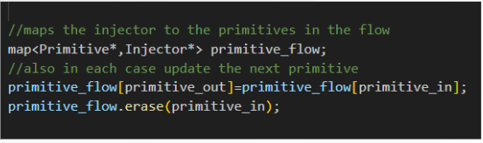
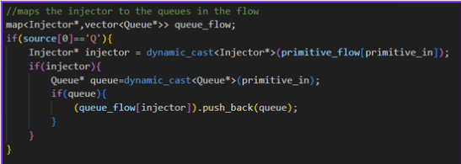
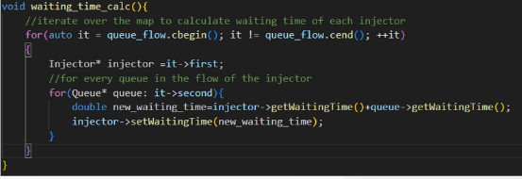
WAITING TIME CALCULATION
WAITING TIME OF INJECTOR IS THE SUM OF WAITING TIMES OF QUEUES ENCOUNTERED IN ITS FLOW
Maintain a map between the injector and the primitives encountered in its flow.
If the encountered primitive is a queue, then push it to a vector mapped to the injector.

Slide 8
Agenda
Recap
New Modifications
Sample Results
Next Steps

Slide 9
Updates to Class Queue
New Data Members
injection_rate: Represents the rate at which packets are injected into the queue.
coeff_interarrival_time: Represents the coefficient used to calculate inter-arrival times between packets.
New Member Functions
setInjectionRate(double &new_injection_rate):Sets the injection rate for the queue.
setCoeffInterArrivalTime(double &new_coeff_interarrival_time) :Updates the coefficient for inter-arrival time calculation.
setWaitingTime(double &new_waiting_time):Sets the waiting time for the queue.

Slide 10
Updates to Class Node
New Data Members
injection_rate
coeff_interarrival_time
New Member Functions
getInjectionRate()
getCoeffInterArrivalTime()
setInjectionRate(double &new_injection_rate)
setCoeffInterArrivalTime(double &new_coeff_interarrival_time)

Slide 11
Updates to Class Injector
New Data Members
waiting_time: Represents the time Injector spend waiting before being processed.
New Member Functions
getWaitingTime() :Retrieves the current waiting time for the injector.
setWaitingTime(double &new_waiting_time) :Updates the waiting time for the injector.

Slide 12
Agenda
Recap
New Modifications
Sample Results
Next Steps

Slide 13
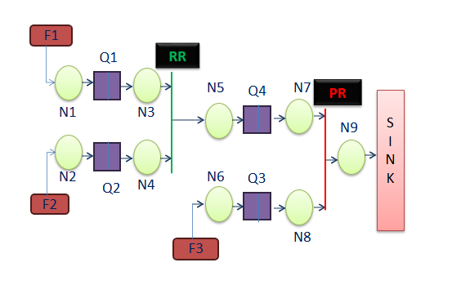
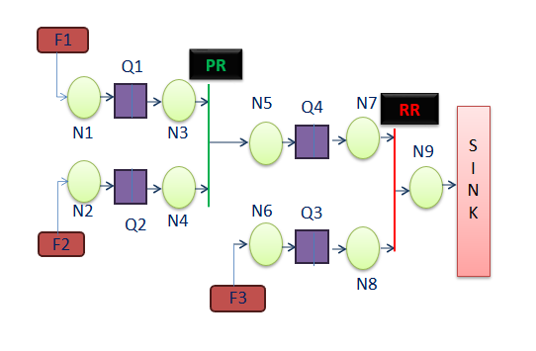
Configurations
RR(Round Robin) followed by PR(PRiority)
PR followed by RR

Slide 14
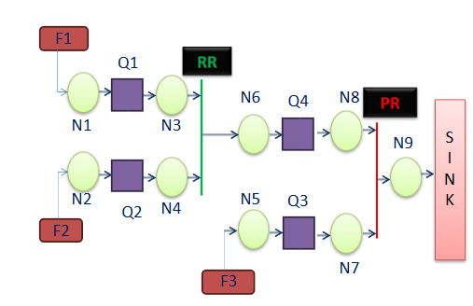
Network Obtained using Input Files and it's Corresponding Output
Output
Input Files
Injector: F1 Waiting time: 4.94669
Injector: F2 Waiting time: 4.94669
Injector: F3 Waiting time: 1.27776
Queue: Q1 Waiting time: 1.1126
Queue: Q2 Waiting time: 1.1126
Queue: Q3 Waiting time: 1.27776
Queue: Q4 Waiting time: 3.83409
statistics.txt
Network.txt
F1=0.05,0.95
F2=0.05,0.95
F3=0.08,0.91
Q1=4,1
Q2=4,1
Q3=4,1
Q4=2,1
RR1=4.0,0.0
PR1=4.0,0.0
N1:F1,Q1
N2:F2,Q2
N3:Q1,RR1
N4:Q2,RR1
N5:F3,Q3
N6:RR1,Q4
N7:Q3,PR1
N8:Q4,PR1
N9:PR1,Sink
Intermediate inputs
Queue Flow
F1: Q1,Q4
F2: Q2,Q4
F3: Q3
QUEUE | Inj.rate | Coeff | buffer
Q1 | 0.05 | 0.95 | 4
Q2 | 0.05 | 0.95 | 4
Q3 | 0.08 | 0.91 | 4
Q4 | 0.1 | 0.95 | 2

Slide 15
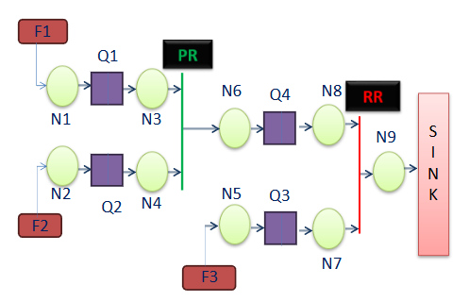
Network Obtained using Input Files and it's Corresponding Output
Output
Input Files
Injector: F1 Waiting time: 2.83394
Injector: F2 Waiting time: 3.66276
Injector: F3 Waiting time: 2.25662
Queue: Q1 Waiting time: 0.747892
Queue: Q2 Waiting time: 1.5767
Queue: Q3 Waiting time: 2.25662
Queue: Q4 Waiting time: 2.08605
statistics.txt
Network.txt
F1=0.05,0.95
F2=0.05,0.95
F3=0.08,0.91
Q1=4,1
Q2=4,1
Q3=4,1
Q4=2,1
RR1=4.0,0.0
PR1=4.0,0.0
N1:F1,Q1
N2:F2,Q2
N3:Q1,PR1
N4:Q2,PR1
N5:F3,Q3
N6:PR1,Q4
N7:Q3,RR1
N8:Q4,RR1
N9:RR1,Sink
Intermediate inputs
Queue Flow
F1: Q1,Q4
F2: Q2,Q4
F3: Q3
QUEUE | Inj.rate | Coeff | buffer
Q1 | 0.05 | 0.95 | 4
Q2 | 0.05 | 0.95 | 4
Q3 | 0.08 | 0.91 | 4
Q4 | 0.1 | 0.95 | 2

Slide 16
Agenda
Recap
New Modifications
Sample Results
Next Steps

Slide 17
Next Steps
Handling Complex Configurations:
Implementing methods to track each flow till the sink, even in highly complex configurations.
Handling Finite Buffers:
Updating the code to deal with cases where buffers have limited size and see how it affects performance.

